Slide 1

FINAL MAJOR PROJECT EXTERNAL EVALUATION
Indoor Air Quality Determination and Purification Using IOT
PRESENTED BY:
VINEET VATS
ABHIJEET SINGH
SIDHANTH SUMAN

Slide 2
INTRODUCTION
The research paper showcases a tool that has been developed to monitor the air quality in our surroundings. The paper covers the implementation, methodology, and related research on this tool.
The methodology used in this research paper involves a systematic approach to developing the air quality monitoring tool. It includes defining the problem statement, identifying the requirements and constraints, designing the solution, implementing the solution, and testing and evaluating the tool's performance.
The air quality monitoring will be carried out using ThingSpeak, which will enable users to access the data and take corrective measures to prevent air pollution.
The system will provide real-time air quality data on an LCD display (16*2) and a webpage, making it convenient for users to monitor the air quality without any hassle.

Slide 3
OBJECTIVES OF THE TOOL
The objectives of the tool are as follows:
Determination of harmful gases in vicinity of tool Like ammonia, sulfur dioxide, and carbon dioxide
Detection of LPG, propane, and butane from gas leaks in homes or businesses.
Measure the temperature and humidity of the surrounding environment
Process All the data retrieved and avail the same to the user periodically
Purification of the Polluted environment after being detected

Slide 4
IMPLEMENTATION
The Internet of Things-based air quality monitoring and low-cost air filter system is meant to assess important air contaminants and present real-time data on air quality using an interface that is appealing to users.
The data is first displayed on the LCD screen and then sent to the Wi-Fi module. The Wi-Fi module transfers the measured data valve to the server via internet. The Wi-Fi module is configured to transfer measured data an application on a remote server called “Thing speak”.
The online application provides global access to measured data via any device that has internet connection capabilities. Data collected from the sensor was converted into a string and used to update the information sent to the remote server.
Users of the ThingSpeak platform may be informed when the air quality reaches levels that are harmful via the use of warnings and notifications that can be set up on the platform.

Slide 5
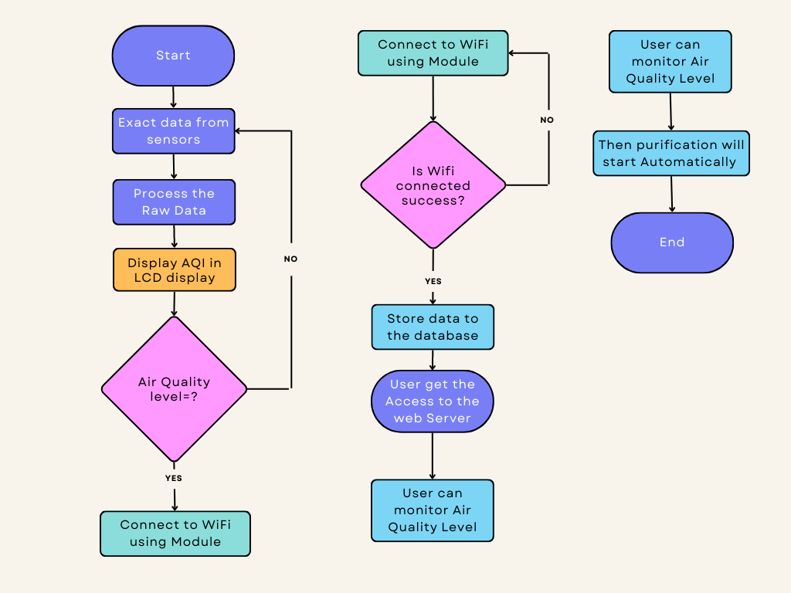
FLOWCHART

Slide 6
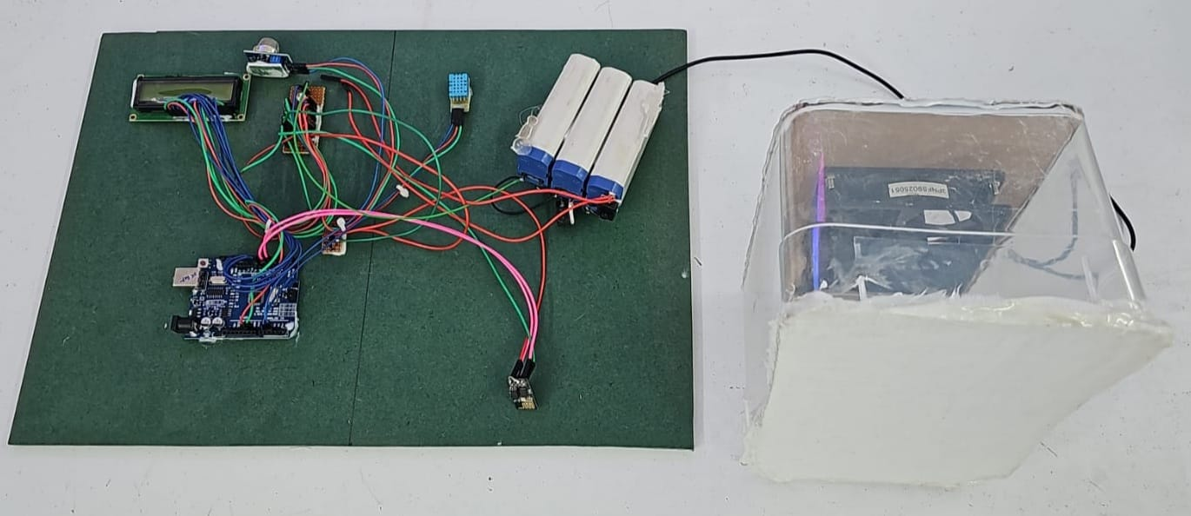
IMPLEMENTATION

Slide 7
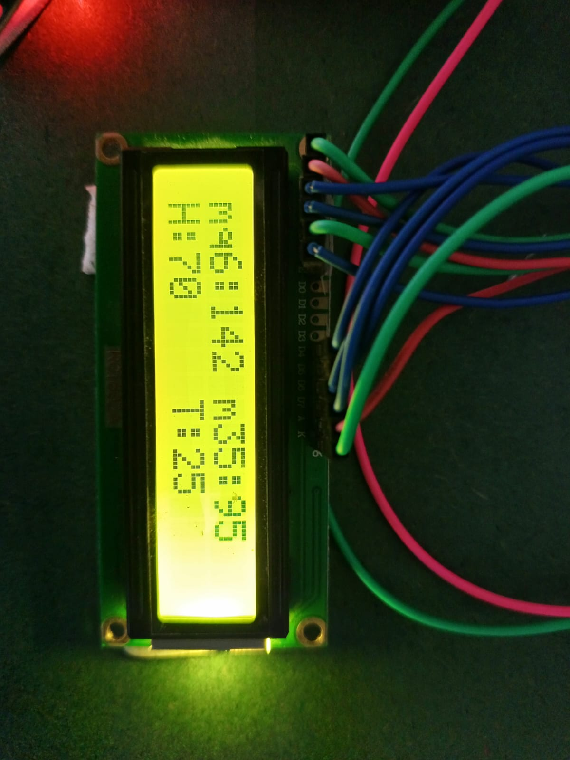
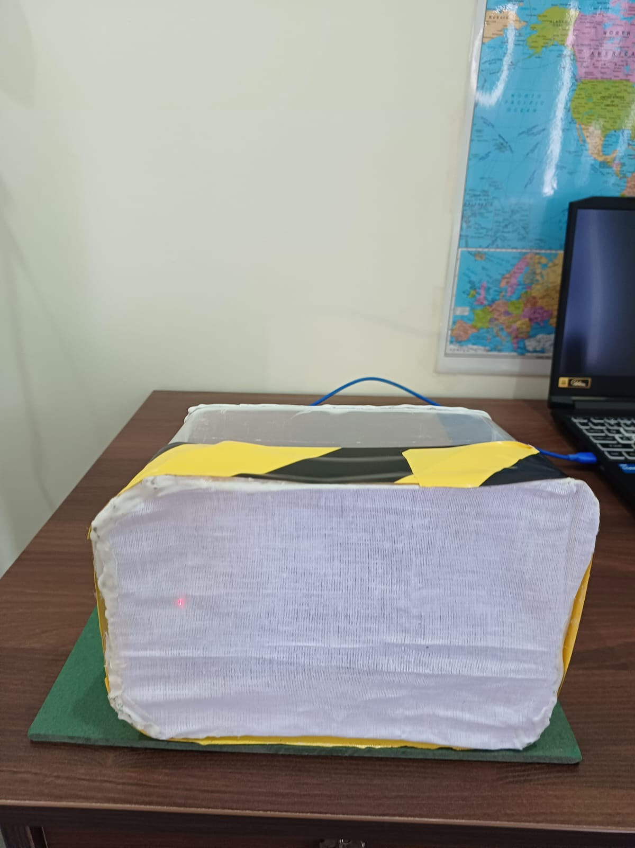
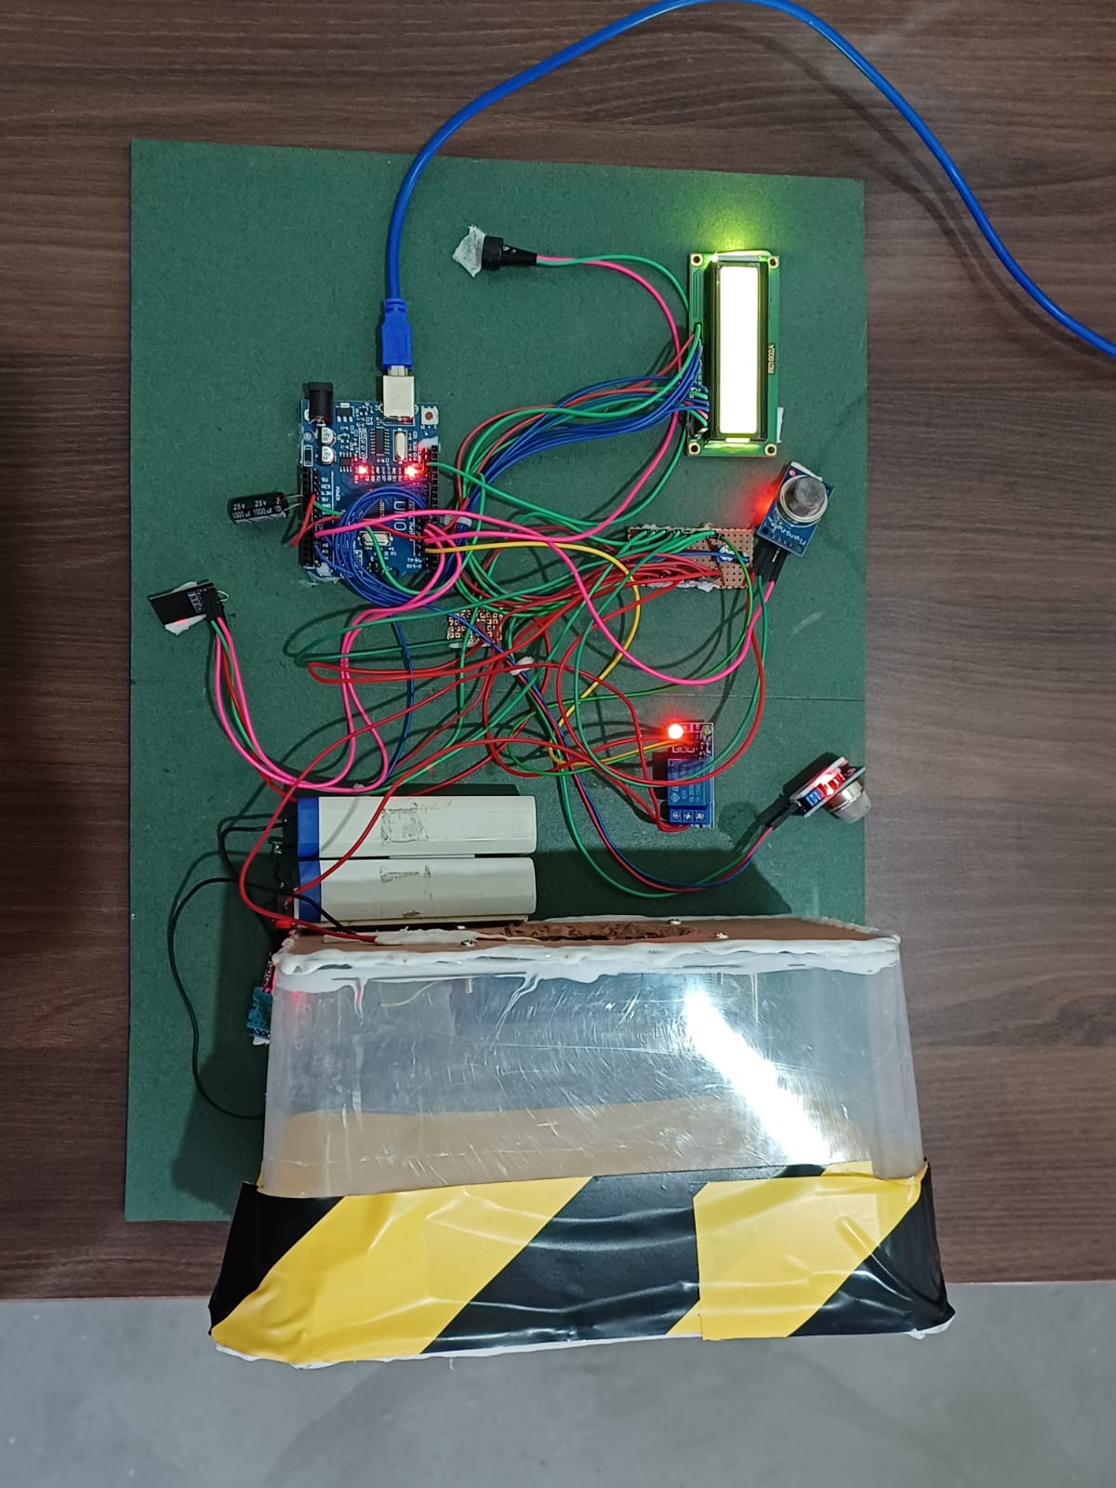
Overview Of The Tool
FILTRATION
LCD DISPLAY(16*2)
PROJECT PROTOTYPE

Slide 8
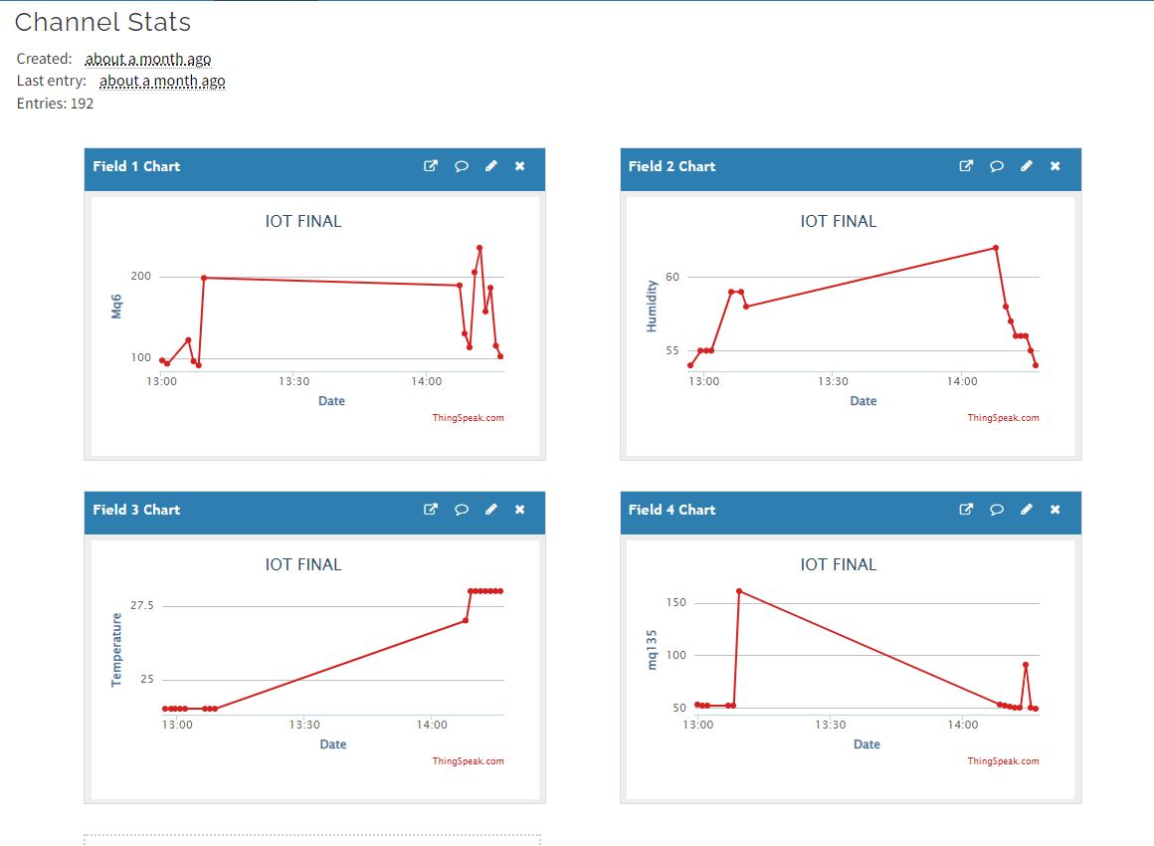
RESULT

Slide 9
FUTURE SCOPE
The air quality monitoring tool could be used in schools and universities to educate students on air pollution and its effects on health and the environment.
The tool could be integrated with mobile applications, allowing users to access real-time air quality data on their smartphones and receive alerts and recommendations based on their location.
The system could be expanded to include a network of sensors across a region or city, providing a more comprehensive understanding of air quality patterns and sources of pollution.
The air quality monitoring tool could be integrated with smart home technology, allowing users to automate actions such as turning on air purifiers or adjusting Heating,Ventilation and Air Conditioning(HVAC) systems based on the real-time air quality data.
The tool could be used to track and analyze trends in air quality over time, enabling governments and policymakers to make data-driven decisions and implement targeted interventions to improve air quality.

Slide 10
CONCLUSION
The IoT-based air quality monitoring and low-cost air filter system prototype improved indoor air quality and cost-effective. The DHT11 sensor, ESP8266 WiFi module, Arduino microcontroller, MQ135 and MQ6 gas sensors, and ThingSpeak platform provided real-time air quality data and enabled prompt air pollution mitigation.
The system's accuracy, reliability, and usability were confirmed through indoor testing. The sensors measured temperature, humidity, and pollutant concentrations accurately, and ThingSpeak real-time data presentation let users monitor air quality. The estimated AQI values indicated air quality, enabling users to detect health hazards and take action(PURIFICATION).
Finally, the IoT-based air quality monitoring and low-cost air filter technology may help solve indoor air pollution. Its price and efficiency make it appropriate for broad use in homes, workplaces, and public venues. The technology improves human and environmental health and quality of life by delivering real-time air quality data and an economical air purification solution.

Slide 11
THANK YOU

